Slide 1
SQUIRREL GAME
Try to reach 15 acorns to spend the winter safely. You start with 5 in your cup.
Roll the dice and follow the instructions. Roll the dice as many times as you like.
GAIN X acorn(s) from the reserve and place them on the table.
SHARE X acorn(s) from your reserve or the ones on the table.
Before rolling, choose to end your turn and save the acorns you have on the table.
'Lose all your unsaved nuts’: lose all the acorns on the table. Your turn ends.
If you run out of acorns, end your turn. You will be able to try again next turn.
Unexpected events: draw a card from the pile ‘unexpected events’ and follow the instruction.

Slide 2
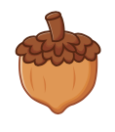


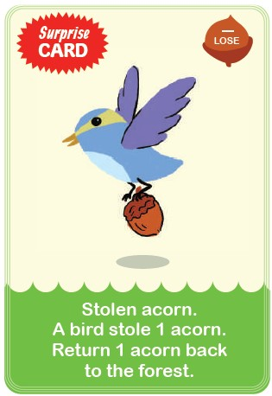

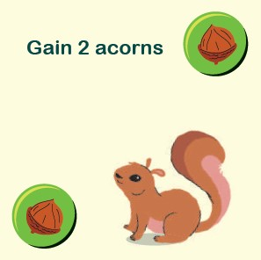
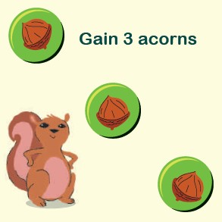
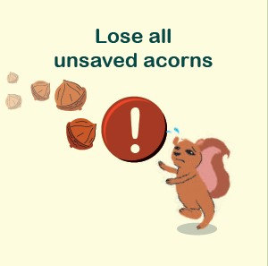
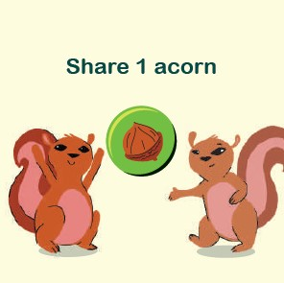

Player 2 loses anything not in the bank
Next player
Bank
Player 2
Player 1
Bank
Player 1 stops
Bank = acorns safe
Next player
Player 3 stops
Bank
Next player
Bank
Player 3

