Slide 1
SHOPPING GAME – level 1
RULES
POINTS
Goal: earn the most points
4 shopping items on the table
Values on each and categories
Payment card with amount
Pick a payment card and use it to buy as many items you want in your limit
Then discard the used credit card
1 point per item bought
The player with an expensive item earn 5 extra points

Slide 2



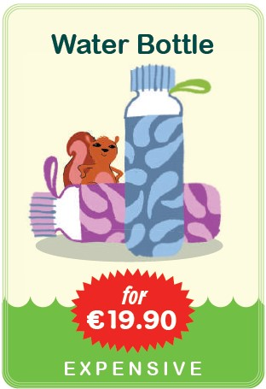
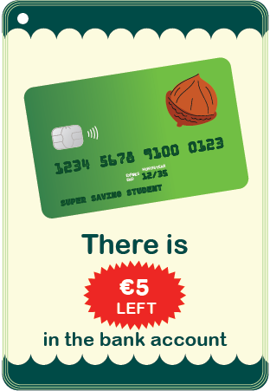

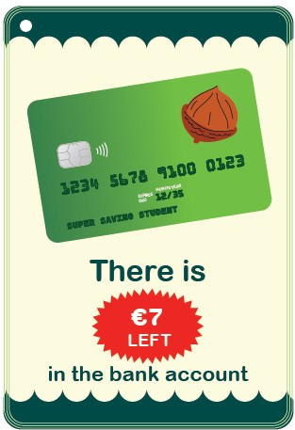
Shop items
pile
Payment
cards
pile
The player draws a payment card. It has €7. The player can buy
A cake and an apple (€6.10)
An apple and a cookie (€3.20)
A cake and a cookie (€6.90)
Then the payment card will be discarded. Shop items will be replaced, so there are always 4. And the next player will draw a new payment card
Payment cards
discarded

Slide 3
SHOPPING GAME – level 2
RULES
EXTRA RULE
Goal: earn the most points
4 shopping items on the table
Values on each and categories
Credit card with amount
Pick a credit card and use it to buy as many items you want in your limit
Then discard the used credit card
You can choose to save instead to buy now.
POINTS
1 point per item bought
If you have a family (3 or more same card family), you double your points of that family
The player with an expensive item earn 5 extra points
1 point per €5 saved

Slide 4
Shop items
pile
Bank
cards
pile
The player draws a payment card. It has €7. The player can buy
A cake and an apple (€6.10)
An apple and a cookie (€3.20)
A cake and a cookie (€6.90) Only one is missing to have family
Saving the money to buy the expensive item next round
Saving money for the end of the game
Then the payment card will be discarded. Shop items will be replaced, so there are always 4. And the next player will draw a new payment card
Bank cards
discarded

