Slide 1
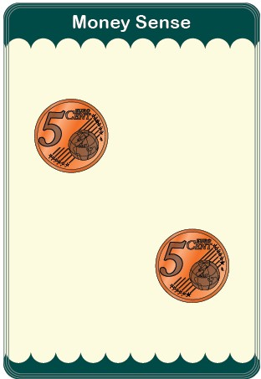
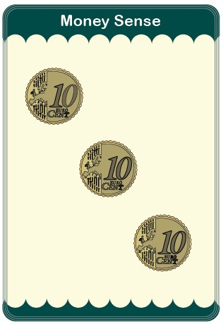
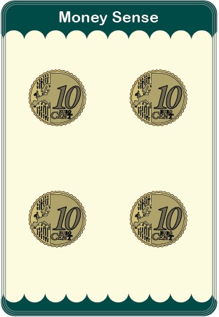
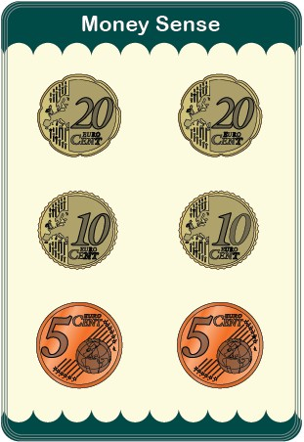
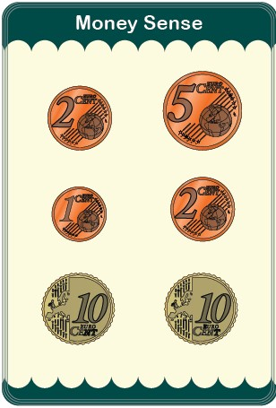
RANKING
Rank the cards in order from the lowest to the highest.
Place the ones with the same value on the same pile.

Slide 2
2. HIGH/ LOW
Aim: to collect all the cards
Deal all the cards, face down. Don’t look at them.
The first player looks at their top card and calls “Low” or “High”.
Then each player reveals their top card and say the value of it out loud.
The lowest or highest (whichever was called) wins all the cards.
Play changes clockwise, until someone has won all the cards.
TIE BREAK
Players who are tied to win draw their next card. The lowest or highest (whichever was called) wins all the cards.

Slide 3
HIGH / LOW
10c
70c
Winner
Card not showed
First Player
Call: Lowest
30c
40c

Slide 4
3. SNAP the COINS
Be the first to collect all the cards
Deal all the cards, face down. Don’t look at them.
First player flips over their top card in front of them so all players can see it and says the value of their card out loud.
Moving clockwise, each player in turn flips over his/her cards and says the value.
If any two face-up cards on the table have the same value of money the first player to shout "Snap!" and slap their own (nearest) pile takes both matched piles only and adds them to the bottom of their face-down pile.
Player who wins a round starts the next round.
TIE BREAK
Players involved draw their next card. The highest value wins all the cards.
PENALTY
If 'snap' is shouted wrongly the face up cards are placed in the middle. At the next correct snap, the winner takes the middle cards as well.

Slide 5
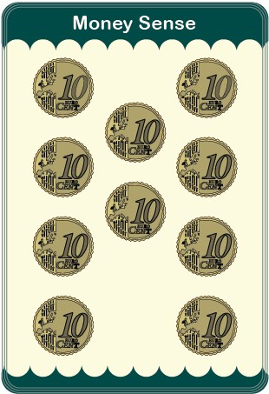

SNAP the COINS
10c
70c
SNAP!
30c
40c
SLAP
Anyone can slap even if you don’t have cards
First Player
If a player runs out of cards, in their face-down pile, the cards in the face-up pile are turned down and the player continues to play.
30c
€1

Slide 6
4. KEEP IT HIGH
Be the first to get rid of all your cards
Deal all the cards, face down. Players look at them and sort them.
The Player with the ‘two 5 cents’ card starts with that card.
Moving clockwise, players place a card in turn with a higher value than the previous one
Say the card value when placing it
Pass if you cannot play
When no one else can place a card that round finishes. All cards in the middle are discarded.
Player who placed the last (highest) card in the previous round starts a new round.
When you have one card left in your hand, it CANNOT be the highest cards (€4 or €3) or you LOSE

Slide 7
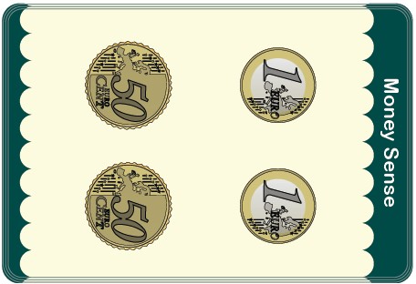


KEEP IT HIGH
40c
70c
€1
Last player is the first player
€3
Cannot play = PASS
30c
30c
No one else can play
CARDS ARE DISCARDED
10c
First Player

