Slide 1
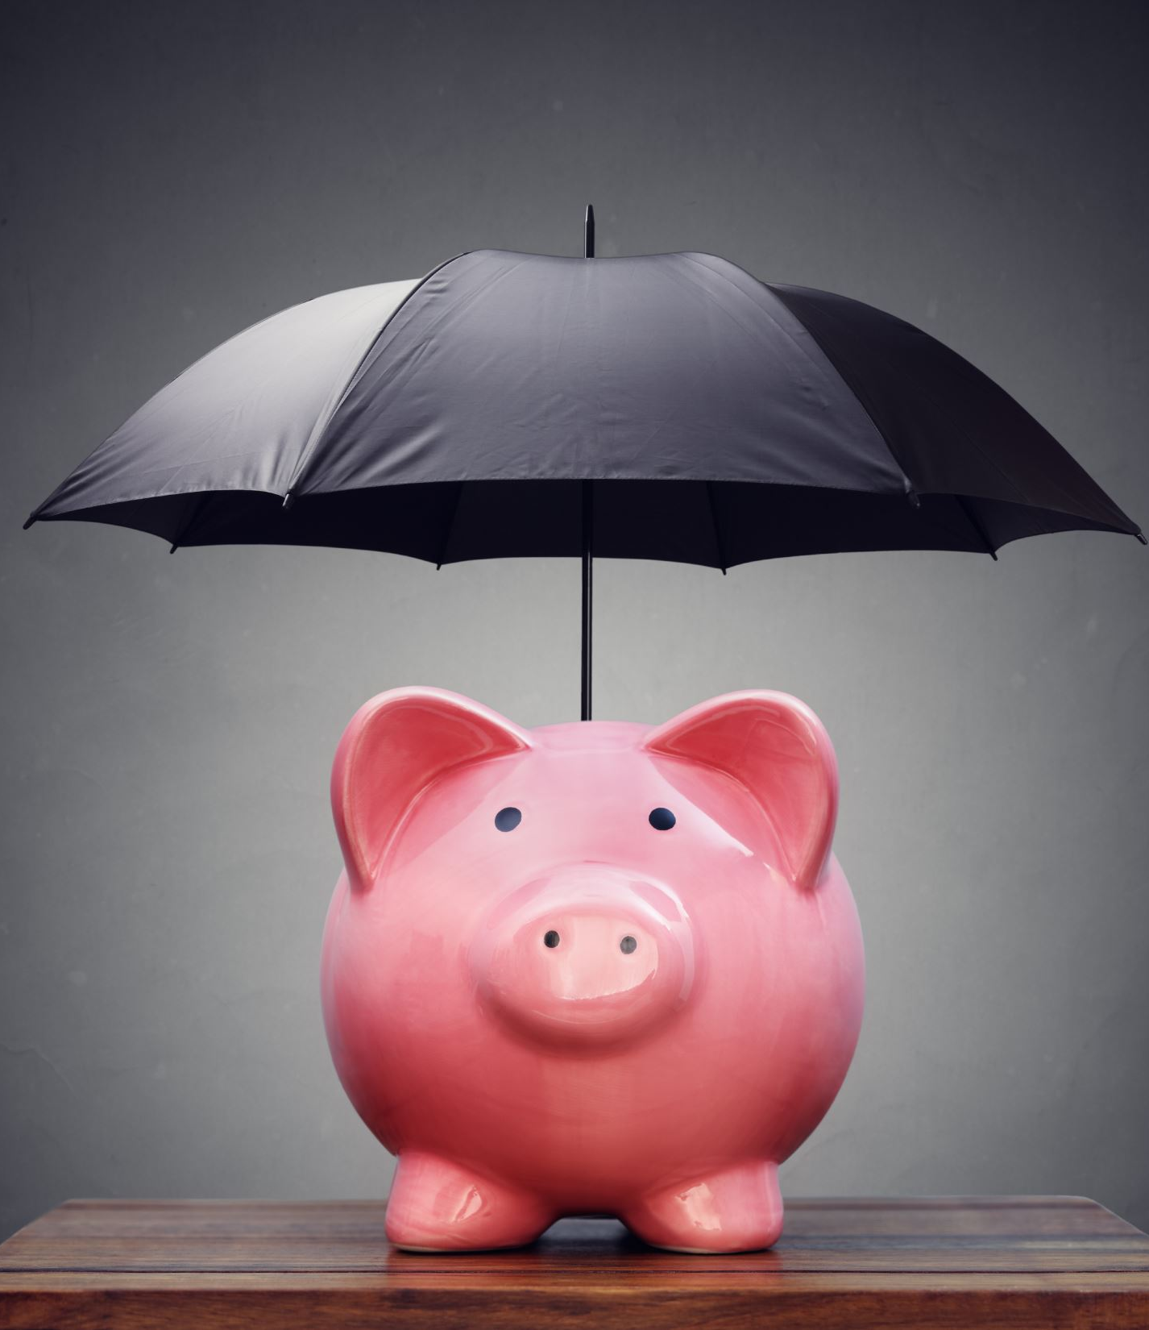



BUDGETING ACTIVITY
A Fun, Collaborative Classroom Activity

Slide 2
Why teach budgeting?
A Essential Life Skill: Budgeting is a key skill for managing money now and in the future.
It's for Everyone: Reassure students that this isn't advanced maths—it's all about basic arithmetic (adding, subtracting, multiplying, dividing).
Goal: To make informed decisions about money by planning, researching, and problem-solving.

Slide 3
What will you do?
Work in small groups (4-6 students) to plan a fictional event.
Decide on a "reasonable" budget.
Research real-world costs online.
Create and balance a budget for their event.
Pitch their final plan to the class.
Notes:
Teacher's Role: Facilitator and guide.
What You Need:
Paper and markers for each group.
Devices with internet access for research.
A whiteboard or flip chart to record class ideas.

Slide 4
Choosing a Scenario
Planning a TY (Transition Year) Trip
Planning a TY Ball
Notes:
Choose one scenario or let the class decide.
Different groups can work on different scenarios to add variety!
The scenario should allow scope for activity and interest and motivate the pupils.

Slide 5
Step 1: Set Your Initial Budget
Group Task: Discuss and agree on...
What is a reasonable and affordable cost per person?
  (e.g., "We think €50 per person is fair for a trip.")
How many participants will there be?
  (e.g., "Our class of 30 students.")
Each group will report their initial cost per head and participant numbers on the board for everyone to see.

Slide 6
Step 2 - Imagine Your Event!
Time to Brainstorm!
Discuss ideas in your group.
Agree on the "dream" version of your event.
If it's a trip: Where will you go? What transport will you use? What activities will you do?
If it's a ball: What is the venue? What about food, music, decorations, and photography?
There is no right or wrong answer — decisions are up to the team

Slide 7
Step 3 - Research & Costing
Now, Get Realistic!
Use the internet to find real costs for each part of your event.
Examples to Research:
  Trip: Bus hire, entry fees to attractions, lunch costs.
  Ball: Venue hire, DJ/band, catering, dress code.
Record all your findings.

Slide 8
Step 4 - Calculate & Compare
The Maths Part (It's simple!):
Total Cost: Add up ALL the costs for your event.
Cost Per Head: Divide the Total Cost by the number of participants.
Compare: How does this new cost per head compare to your initial "reasonable" price?
Does your budget balance, or is there a surprise?

Slide 9
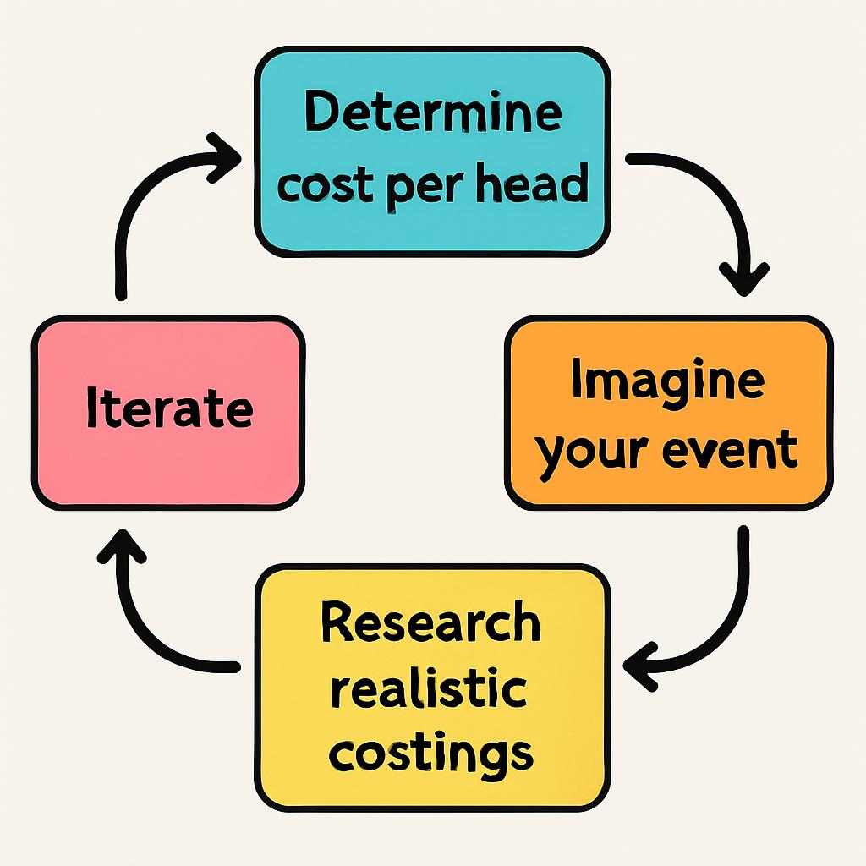
Step 5 - Problem Solve & Iterate
Uh-oh, over budget? This is where it gets interesting!
Group Discussion:
What can you change to balance the budget?
Can you find a cheaper venue or transport?
Can you negotiate a group discount?
Do you need to reduce the number of activities?
Iterate: Adjust your plan and re-calculate until your budget balances!

Slide 10
The Group Pitch
Time to Present!
Each group gives a short pitch to "sell" their event to the class.
What to include in your pitch:
  Your initial budget and your final budget.
  What your event looks like.
  The challenges you faced and how you solved them.

Slide 11
Class Discussion & Reflection
Let's talk
Were you surprised by the cost of anything? Why?
What was the hardest part of balancing the budget?
What is one thing you learned about budgeting?
How could you use these skills in your own life?

Slide 12
Extension Activity: Fundraising
If your event was real, how much money would you need to raise to lower the cost per person?
Brainstorm: How could you raise the money?
Notes:
Cake sale
Sponsored walk
Car wash

Slide 13
Share the Skill!
Teach the budgeting skill!
Can you adapt this activity and run it with a younger class in your school or a local primary school?
This is a powerful way to reinforce your own learning and help others.

